Slide 1


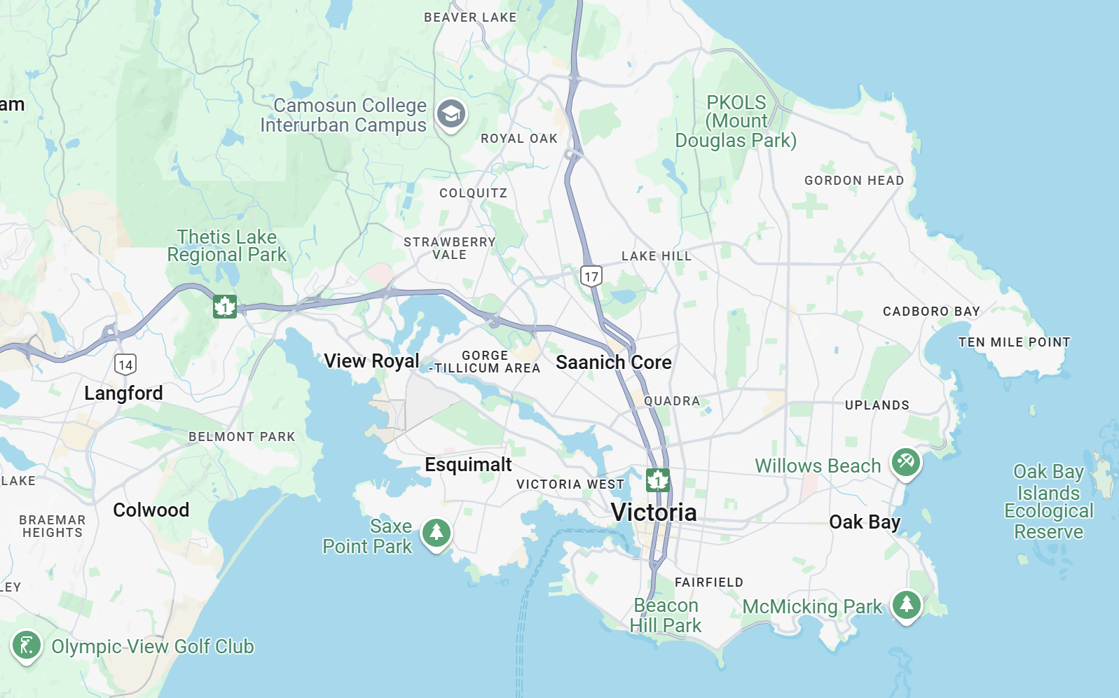
Construction Alert Notification System
Home News About us Self information Login/Signup
Signup/Login
Construction Map Who are we?
We are a company based in the Greater Victoria area. We have partnered up with the city of Victoria to help reduce traffic by helping users avoid construction delays.
User feedback?
Leave feedback here...
Join our Community!
Sign up today and receive notifications tailored to your commute.
Submit
Sign up for free!
Notes:
Homepage

Slide 2
Sorry, This Page is Under Construction
Go Back

Slide 3
Sorry, This Page is Under Construction
Go Back

Slide 4
Please Login First to Use this Feature
Go Back

Slide 5

Construction Alert Notification System
Home News About us Self information John Doe
Construction Map Who are we?
We are a company based in the Greater Victoria area. We have partnered up with the city of Victoria to help reduce traffic by helping users avoid construction delays.
User feedback?
Leave feedback here...
Join our Community!
Sign up today and receive notifications tailored to your commute.
Submit
Sign up for free!
Notes:
Homepage(logged in)

Slide 6




Construction Alert Notification System
Sign in
username: _______
password: _______ 👁
Remember me
or
New to our website? Sign up here!
Sign in
Sign in with Google
Sign in with Facebook
Sign in with Microsoft
Sign in with Apple
Go Back
Notes:
Login Page

Slide 7
Construction Alert Notification System
Sign in
username: John Doe
password: _______ 👁
Remember me
or
New to our website? Sign up here!
Sign in
Sign in with Google
Sign in with Facebook
Sign in with Microsoft
Sign in with Apple
Go Back
Notes:
Login Page

Slide 8
Construction Alert Notification System
Sign in
username: John Doe
password: ********** 👁
Remember me
or
New to our website? Sign up here!
Sign in
Sign in with Google
Sign in with Facebook
Sign in with Microsoft
Sign in with Apple
Go Back
Notes:
Login Page

Slide 9

Construction Alert Notification System
Sign in
username: John Doe
password: ********** 👁
Remember me
or
New to our website? Sign up here!
Sign in
Sign in with Google
Sign in with Facebook
Sign in with Microsoft
Sign in with Apple
Go Back
Notes:
Login Page

Slide 10
Construction Alert Notification System
Home News About Us Self information
New User Sign-up:
Username: _______
Password: _______
Confirm Password: _______
Go Back
Sign up
Notes:
Sign up page (user inputs information)

Slide 11
Construction Alert Notification System
Home News About Us Self information
New User Sign-up:
Username: John Doe
Password: _______
Confirm Password: _______
Go Back
Sign up
Notes:
Sign up page (user inputs information)

Slide 12
Construction Alert Notification System
Home News About Us Self information
New User Sign-up:
Username: John Doe
Password: ********** 👁
Confirm Password: _______
Go Back
Sign up
Notes:
Sign up page (user inputs information)

Slide 13
Construction Alert Notification System
Home News About Us Self information
New User Sign-up:
Username: John Doe
Password: ********** 👁
Confirm Password: ********** 👁
Go Back
Sign up
Notes:
Sign up page (user inputs information)

Slide 14
Construction Alert Notification System
Home News About Us Self information
Enter Daily Commute:
What days do you commute:
Monday Tuesday Wednesday Thursday Friday Saturday Sunday
Time Frame:
Depart: Arrival:
Notification:
Email:
Text:
Go Back
Submit
Notes:
Sign up page (user inputs information)

Slide 15
Construction Alert Notification System
Home News About Us Self information
Enter Daily Commute:
What days do you commute:
Monday Tuesday Wednesday Thursday Friday Saturday Sunday
Time Frame:
Depart: Arrival:
Notification:
Email:
Text:
Go Back
Submit
Notes:
Sign up page (user inputs information)

Slide 16
Construction Alert Notification System
Home News About Us Self information
Enter Daily Commute:
What days do you commute:
Monday Tuesday Wednesday Thursday Friday Saturday Sunday
Time Frame:
Depart: Arrival:
Notification:
Email:
Text:
Go Back
Submit
Notes:
Sign up page (user inputs information)

Slide 17
Construction Alert Notification System
Home News About Us Self information
Enter Daily Commute:
What days do you commute:
Monday Tuesday Wednesday Thursday Friday Saturday Sunday
Time Frame:
Depart: Arrival:
7:00
8:00
9:00
Notification:
Email:
Text:
Go Back
Submit
Notes:
Sign up page (user inputs information)

Slide 18
Construction Alert Notification System
Home News About Us Self information
Enter Daily Commute:
What days do you commute:
Monday Tuesday Wednesday Thursday Friday Saturday Sunday
Time Frame:
Depart: Arrival:
8:00
Notification:
Email:
Text:
Go Back
Submit
Notes:
Sign up page (user inputs information)

Slide 19
Construction Alert Notification System
Home News About Us Self information
Enter Daily Commute:
What days do you commute:
Monday Tuesday Wednesday Thursday Friday Saturday Sunday
Time Frame:
Depart: Arrival:
8:00
7:00
8:00
9:00
Notification:
Email:
Text:
Go Back
Submit
Notes:
Sign up page (user inputs information)

Slide 20
Construction Alert Notification System
Home News About Us Self information
Enter Daily Commute:
What days do you commute:
Monday Tuesday Wednesday Thursday Friday Saturday Sunday
Time Frame:
Depart: Arrival:
8:00
9:00
Notification:
Email:
Text:
Go Back
Submit
Notes:
Sign up page (user inputs information)

Slide 21
Construction Alert Notification System
Home News About Us Self information
Enter Daily Commute:
What days do you commute:
Monday Tuesday Wednesday Thursday Friday Saturday Sunday
Time Frame:
Depart: Arrival:
8:00
9:00
Notification:
Email:
Text:
Go Back
Submit
Notes:
Sign up page (user inputs information)

Slide 22
Construction Alert Notification System
Home News About Us Self information
Enter Daily Commute:
What days do you commute:
Monday Tuesday Wednesday Thursday Friday Saturday Sunday
Time Frame:
Depart: Arrival:
8:00
9:00
Notification:
Email:
Text:
Johndoe@gmail.com
Go Back
Submit
Notes:
Sign up page (user inputs information)

Slide 23
Success!
Congratulations, John Doe! Your account has been successfully created.
Click the button below to proceed to sign in.
Sign in to your account
Notes:
Sign up success page

Slide 24
Success!
Congratulations! Your self information is set.
Notes:
Sign up success page

Slide 25




Wednesday, June 5
7:00
1m ago
You have a new message
Notes:
Phone screen

Slide 26





Construction Alert: Road Close on
Shelbourne Street Tomorrow
Construction Alert Notification System <do-not-reply-324729387482@cans.ca>
Hi John,
we’re sending you a construction alert based on your saved preferences.
Details:
Location: Shelbourne Street between Mckenzie Ave and Cedar Hill Cross Rd.
Date: Thursday, June 6 (8:00AM) - June 7 (12:00PM)
Level: Full Road Closure
Live map update available: View Interactive Map
More:
Reported By: City of Victoria (Public Works)
Official Notice: victoria.ca/construction-notice
Notes:
Email

